Slide 1

WEB SCRAPING AND EDA ON
Resale Cars

Slide 2
Why Data Science ?
About me
Name: Sai Manoj Reddy Vancha.
Qualification: B. Tech, Civil Engineering(2019)
Work Experience: 2 Years
Data science is an exciting field where you can tackle real world problems by working with data
Data Science offer smoother transition for the people of other background in to the tech field compare to other positions
Data Science will aid in employment opportunities in a variety of fields from data engineering to AI/ML specialists.

Slide 3
Resale car Analysis
Problem Statement
We can get information regarding resale cars from different website but I used the following website because it provides different information.
Website used: www.cars24.com
Objective
To scrap the details of resale cars from south Indian market and make the required analysis.

Slide 4
STEPS FOLLOWED
Load the required libraries
Get the URL
Scrap the required features
Convert into data frame
Data cleaning
Data visualization

Slide 5
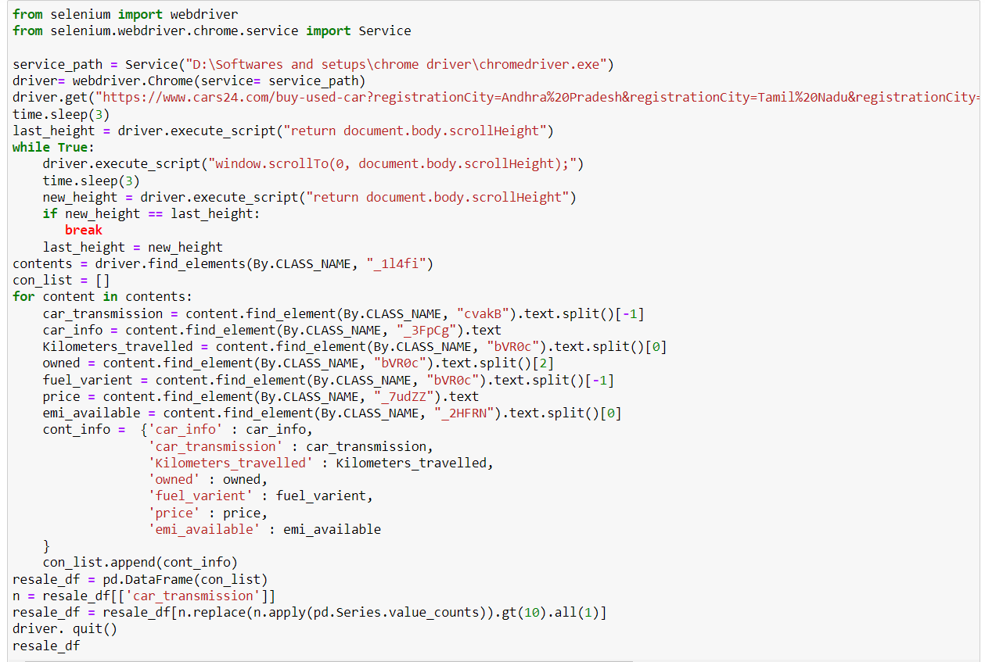
SCRAPED RAW DATA PROCESS

Slide 6
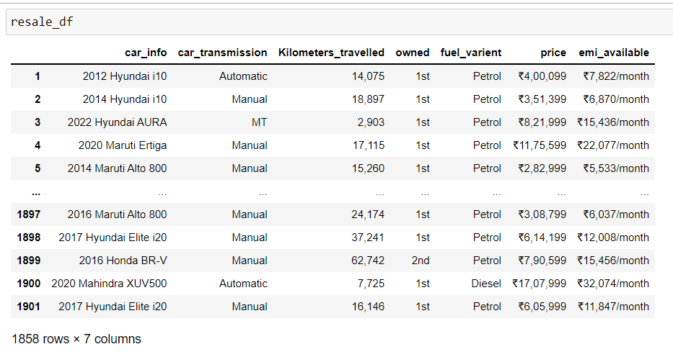
SCRAPED RAW DATA

Slide 7
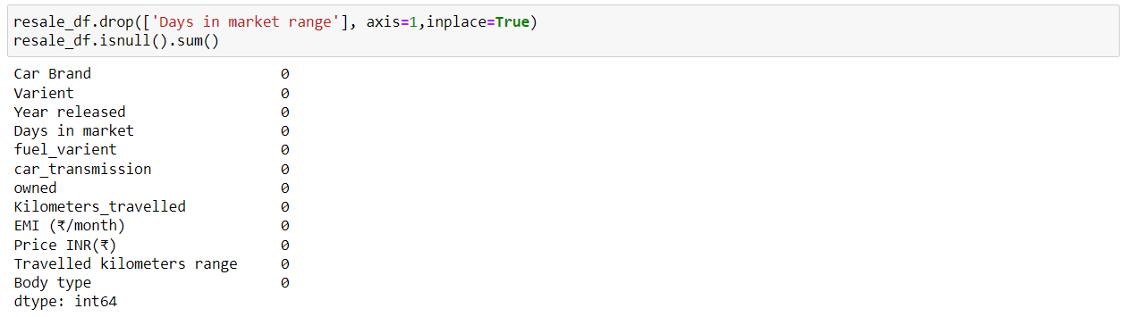
DATA CLEANING
Removing of null values
Removing of special characters
Changing data types
REMOVING OF NULL VALUES

Slide 8
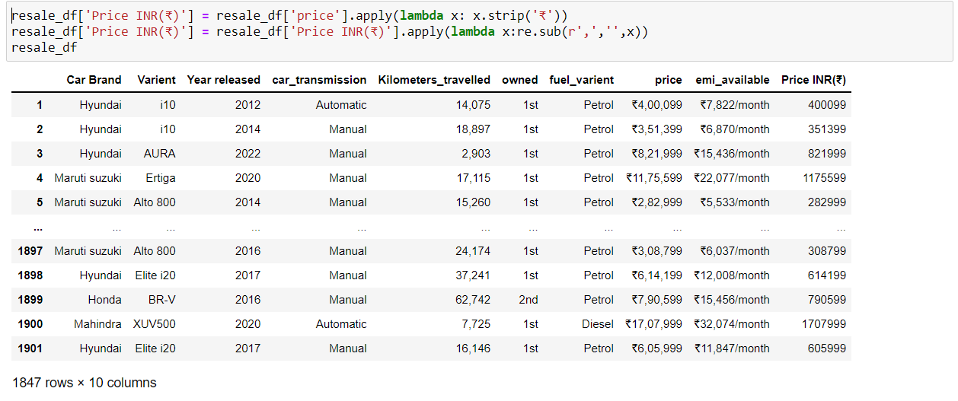
DATA CLEANING
REMOVING SPECIAL CHARACTERS

Slide 9
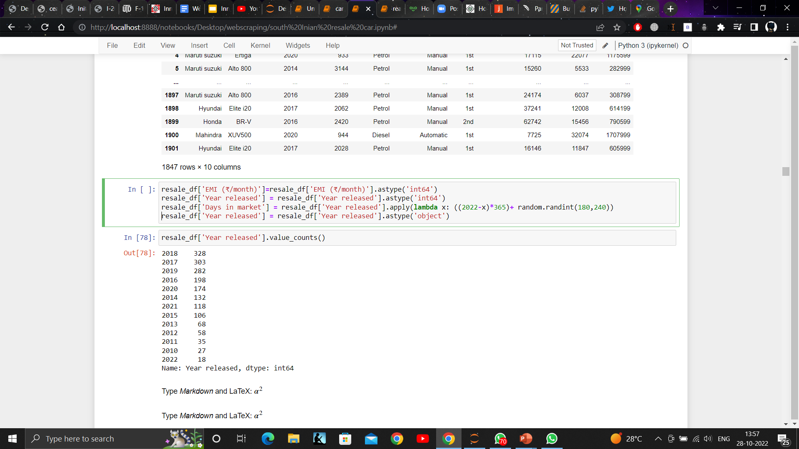
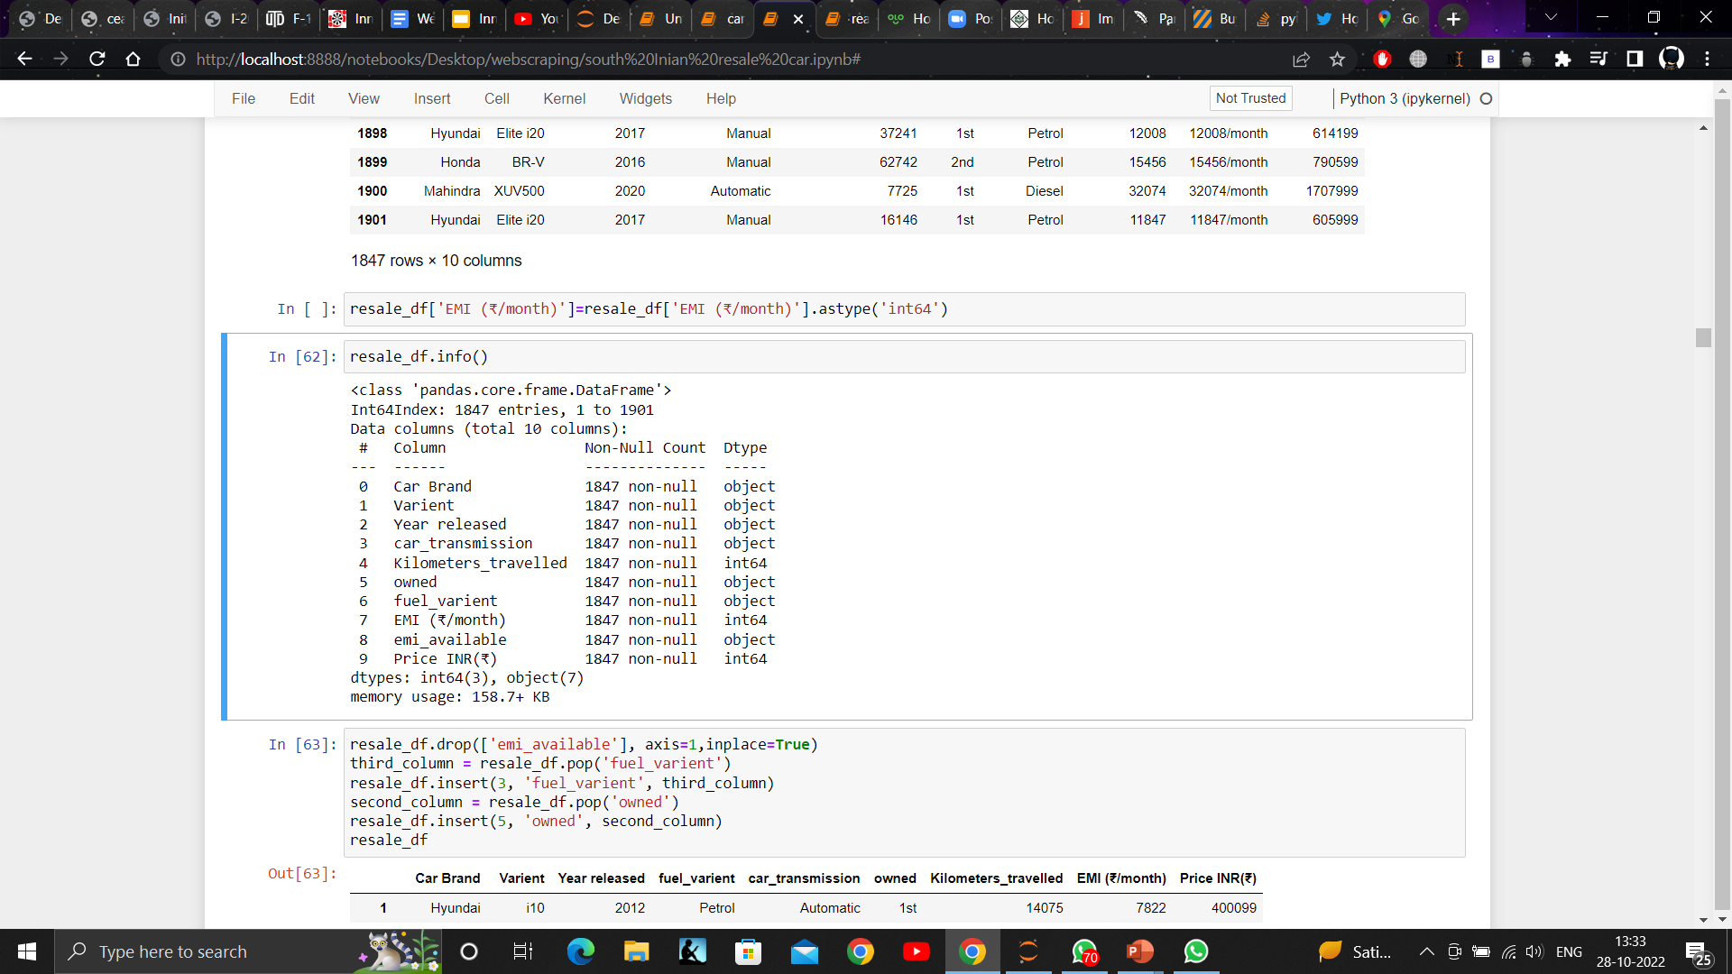
DATA CLEANING
CHANGING DATA TYPES

Slide 10
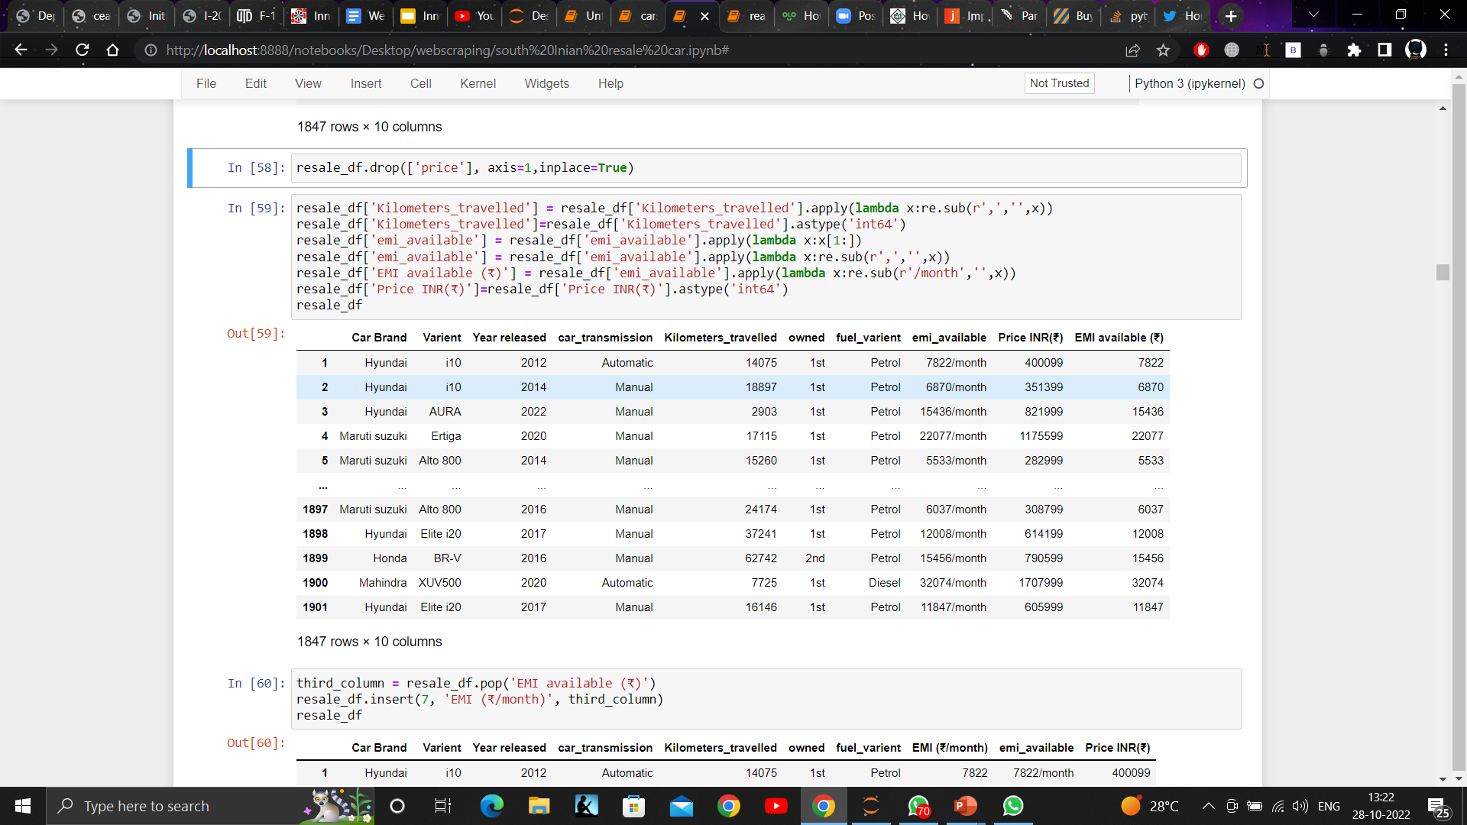
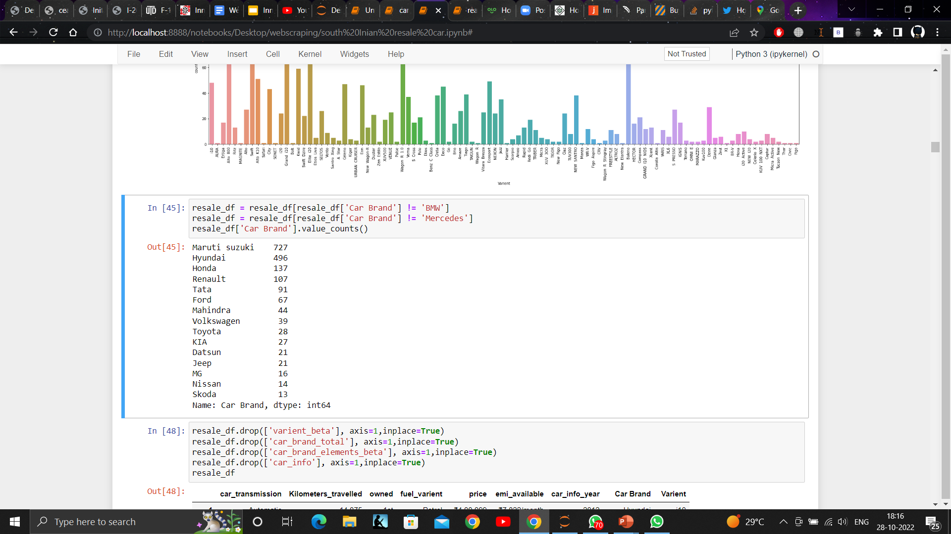
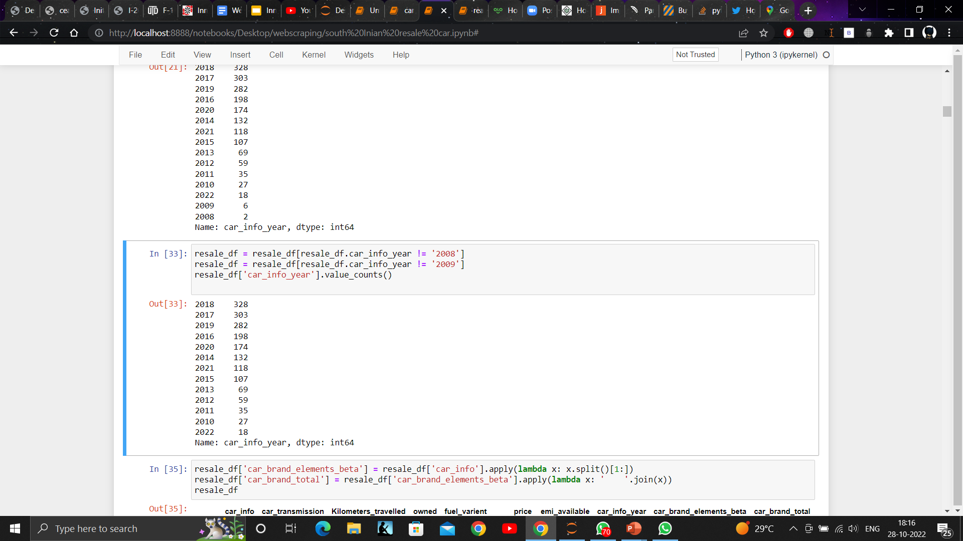
DATA MANIPULATION

Slide 11
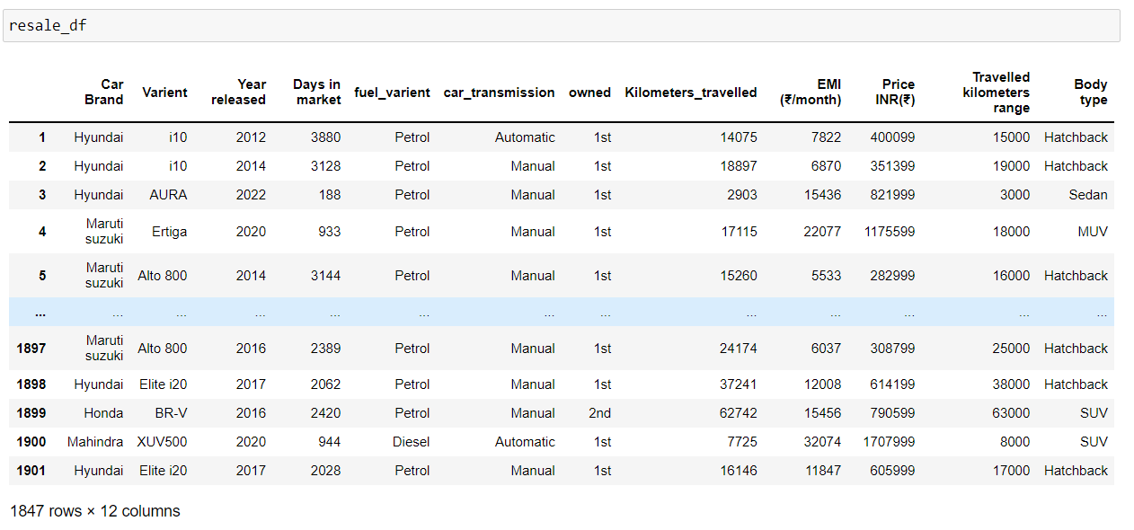
FINAL DATA SET

Slide 12
Exploratory Data Analysis
EDA Involves:
Univariate Analysis
This type of data consists of only one variable. The analysis of univariate data is thus the simplest form of analysis since the information deals with only one quantity that changes.
Bivariate Analysis
This type of data involves two different variables. The analysis of this type of data deals with causes and relationships and the analysis is done to find out the relationship among the two variables
Multivariate Analysis
When the data involves three or more variables, it is categorized under multivariate.

Slide 13
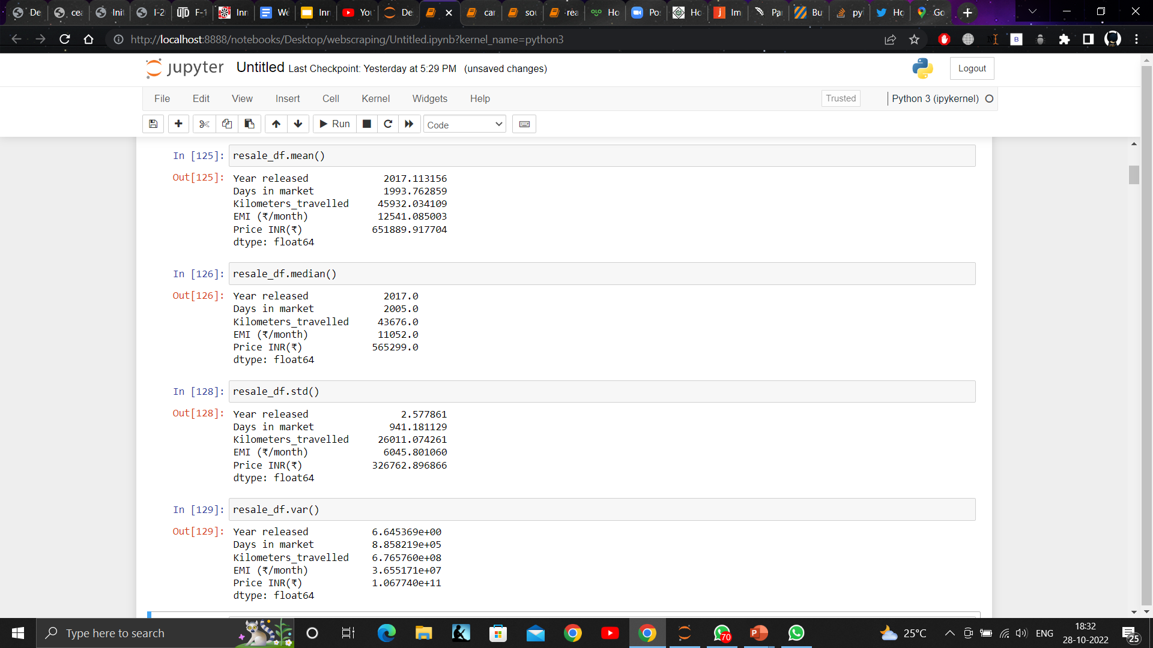
UNIVARIATE ANALYSIS
Mean
Median
Variance
Standard deviation

Slide 14
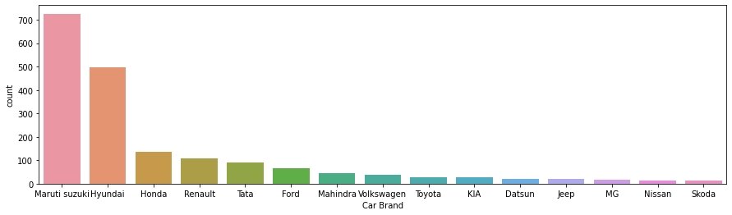
BAR PLOT
There are 726 Maruti Suzuki cars listed on the website which is highest
Hyundai is the second most cars listed on the website which is around 496

Slide 15
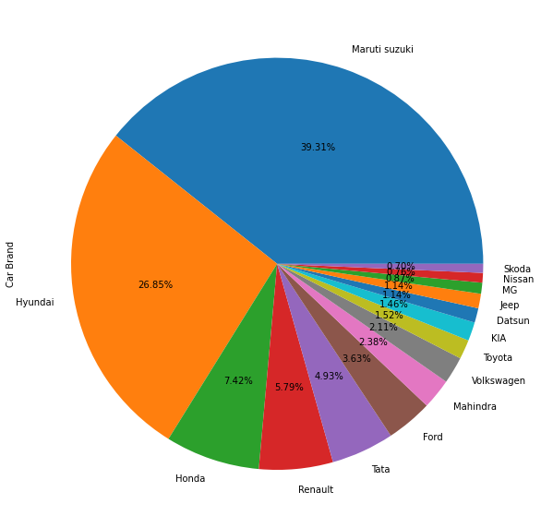
PIE CHART
The Maruti Suzuki cars listed around 40% on the website which is highest
Hyundai is listed around 27% on the website

Slide 16
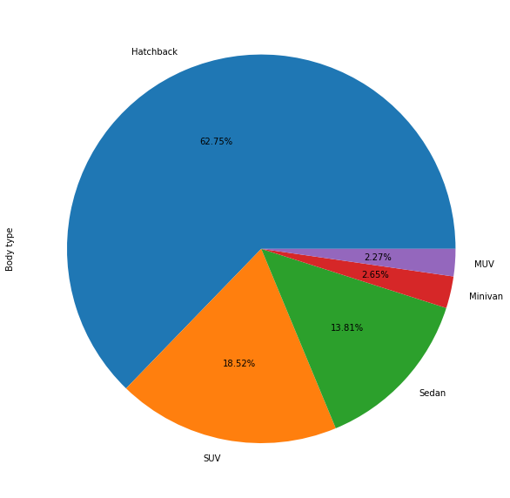
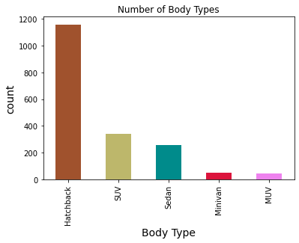
BAR PLOT AND PIE CHART OF BODYTYPE
When it comes to body types Hatchback series is the highest listed bodytype around 1159 (62.75%)
SUV is the second most listed variant which is around 342 (18.52%)

Slide 17
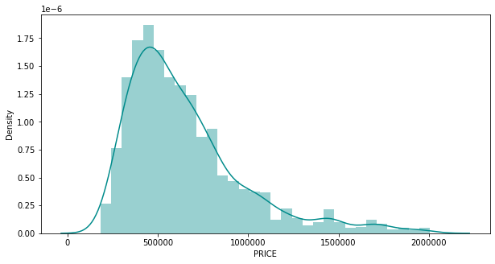
DIST PLOT
Most Number of cars are priced around INR 5,00,000.

Slide 18
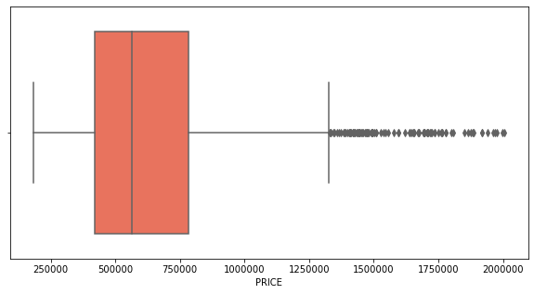
BOX PLOT
The interquartile range is ₹. 3,63,750
The median is around ₹. 5,65,300
Q1 i.e., Lower Quartile is around ₹. 4,20,900
Q3 i.e., Upper Quartile is around ₹. 7,84,650.

Slide 19
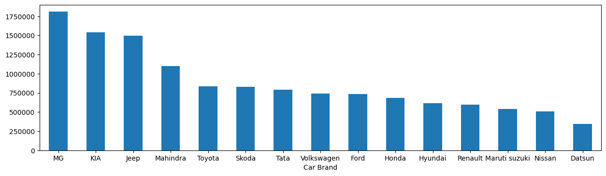
BIVARIATE ANALYSIS
When you look at the average price to a Car Brands, the top three car Brands are MG, KIA, Jeep

Slide 20
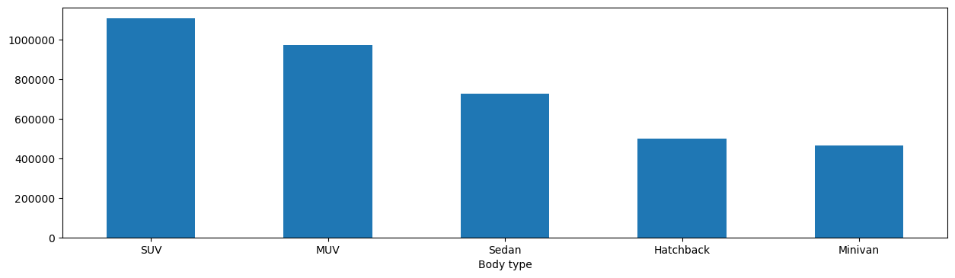
BIVARIATE ANALYSIS
When you look at the average price for Body Type of cars SUV leads the chart

Slide 21
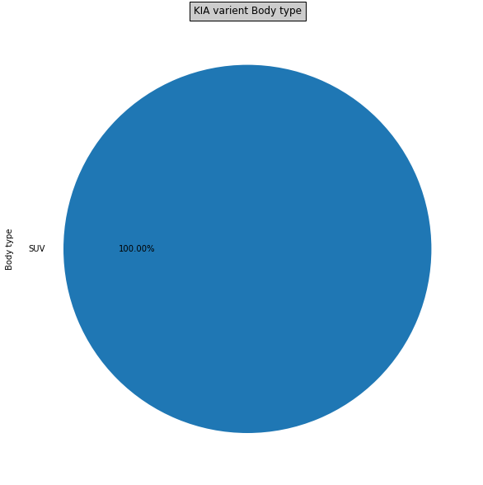


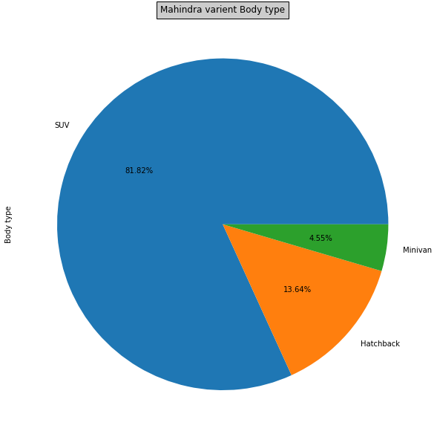
BIVARIATE ANALYSIS
Now if you observe top 4 car brand body types, they are overwhelmingly SUVs

Slide 22
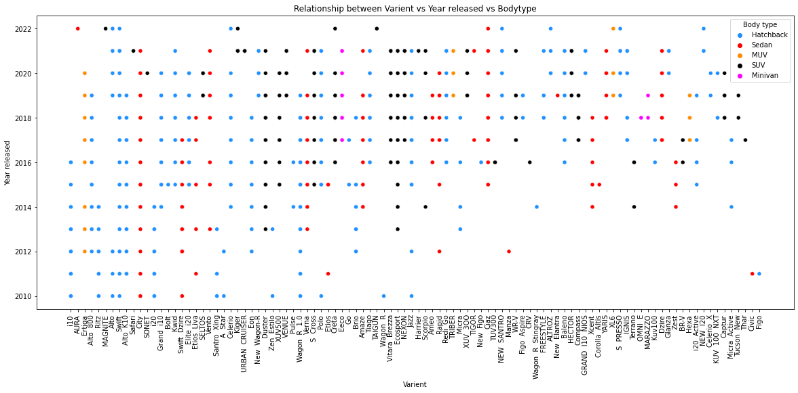
BIVARIATE ANALYSIS
When you see the pattern in body types released over the years, sedan is slowly being replaced by SUVs as second most preferred car types

Slide 23
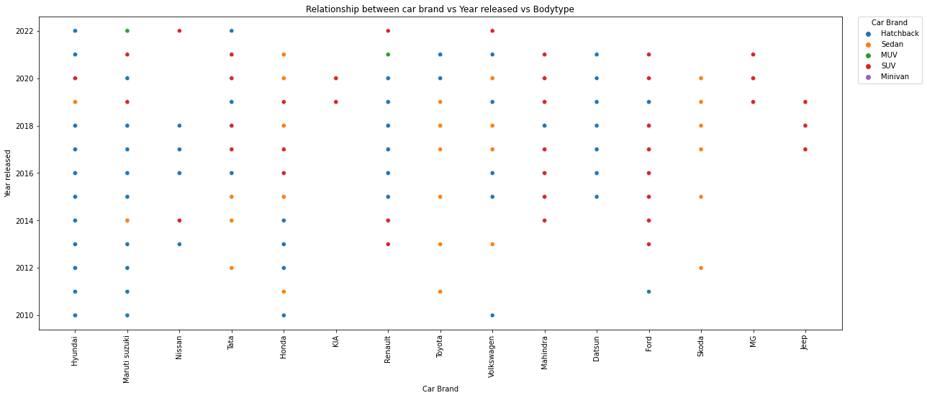
BIVARIATE ANALYSIS
We can find a pattern with the newer car brands strategy by releasing their body types

Slide 24
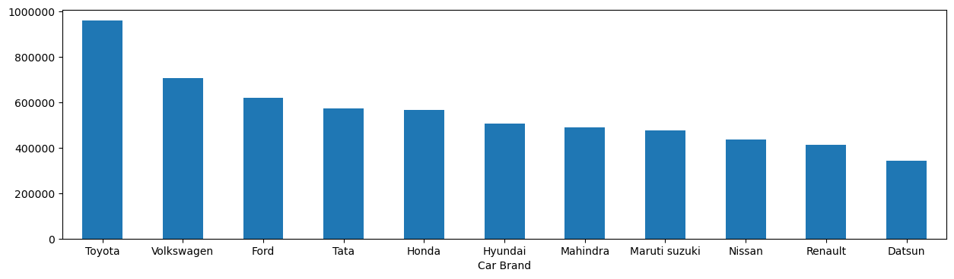
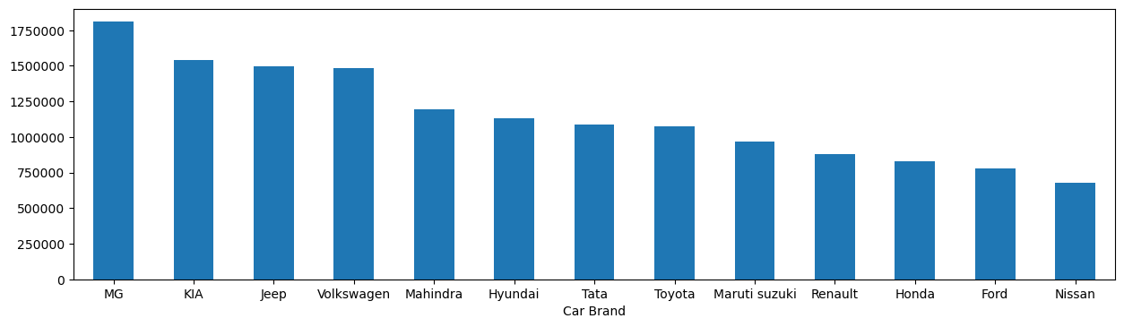
BIVARIATE ANALYSIS
The average price chart of car brands with respect to body types
Hatchback
SUV

Slide 25
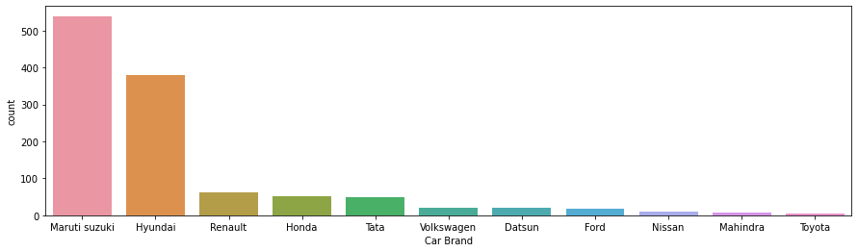
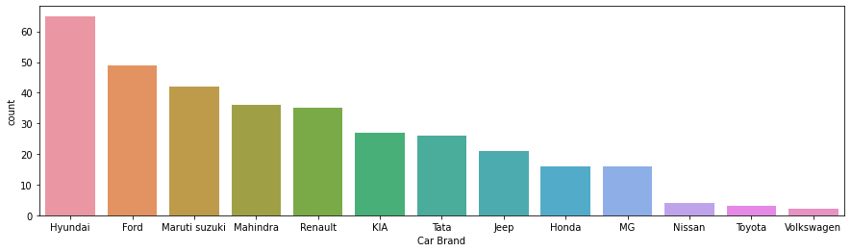
BIVARIATE ANALYSIS
The number of cars released with respect to body types
Hatchback
SUV

Slide 26
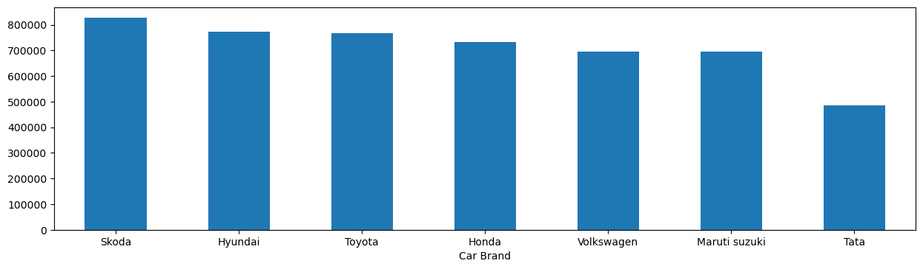
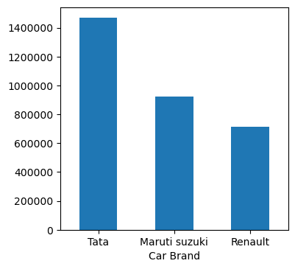
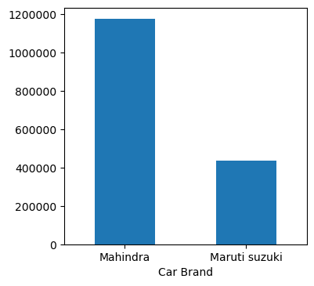
BIVARIATE ANALYSIS
The average price chart of car brands with respect to body types
Sedan
MUV
Minivan

Slide 27
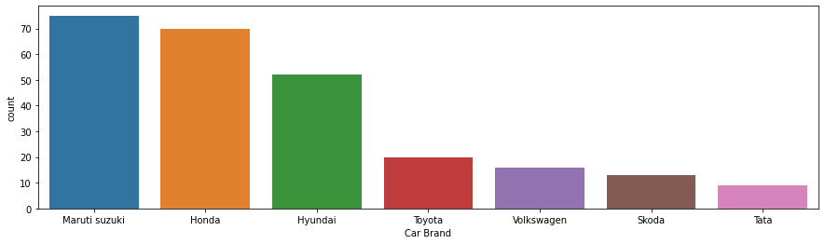
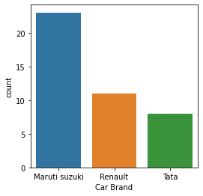
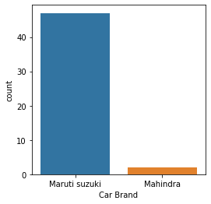
BIVARIATE ANALYSIS
The number of cars released with respect to body types
Sedan
MUV
Minivan

Slide 28
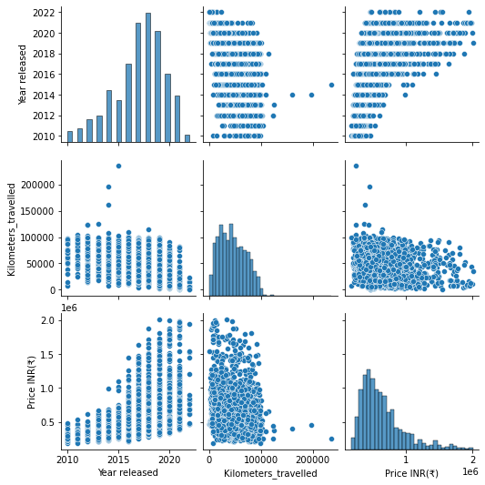
MULTIVARIATE ANALYSIS
PAIR PLOT

Slide 29
SUMMERY OF DATA
The car market is primarily dominated by two Car Brands and they’re Maruti(40%) and Hyundai(27%) combining around 67% which reinforces the public sentiment about these cars
The Hatchback, SUV and Sedan bodytypes are mostly listed on the cars24 website with Hatchback dominating overwhelmingly in the market suggesting that Hatchback is still primary option for many consumers
Maruti and Hyundai are the leading car brands traded in the market indicating that people still prefer these brands majorly
SUVs are becoming most aspirational cars overtaking Sedans over the past few years as Sedan cars started to decrease in sales as the years pass by
Mahindra and KIA has the better resale value when you compare with price to value count but when it comes to total cars listed Hyundai and Ford tops the list

Slide 30
SUMMERY OF DATA
Maruti tops the list with MUV and Mini-van category in the resale market
Most cars are in the range of 5,00,000 INR
The new car brands which are released from the year starting 2018 releasing only SUVs as to give impression that they’re of good quality when it comes to SUVs since it is difficult to change the perception of the people when it comes to Hatchbacks as they’re dominated by Maruti Suzuki
These patterns can be seen in MG Hector, KIA and Jeep

Slide 31
CHALLENGES FACED
Most of the car websites are dynamically loading websites which makes the use of Beautiful soup very difficult
Since this is a resale category, there are outliers in terms of price as they are difficult to regulate.
Most websites provide information when you open the profile of the car listed on websites individually making it difficult to scrape the data
To reduce the outliers a large pool of data is required to perform analysis but the limitations of hardware compromised the scraping of data to its full potential.

Slide 32
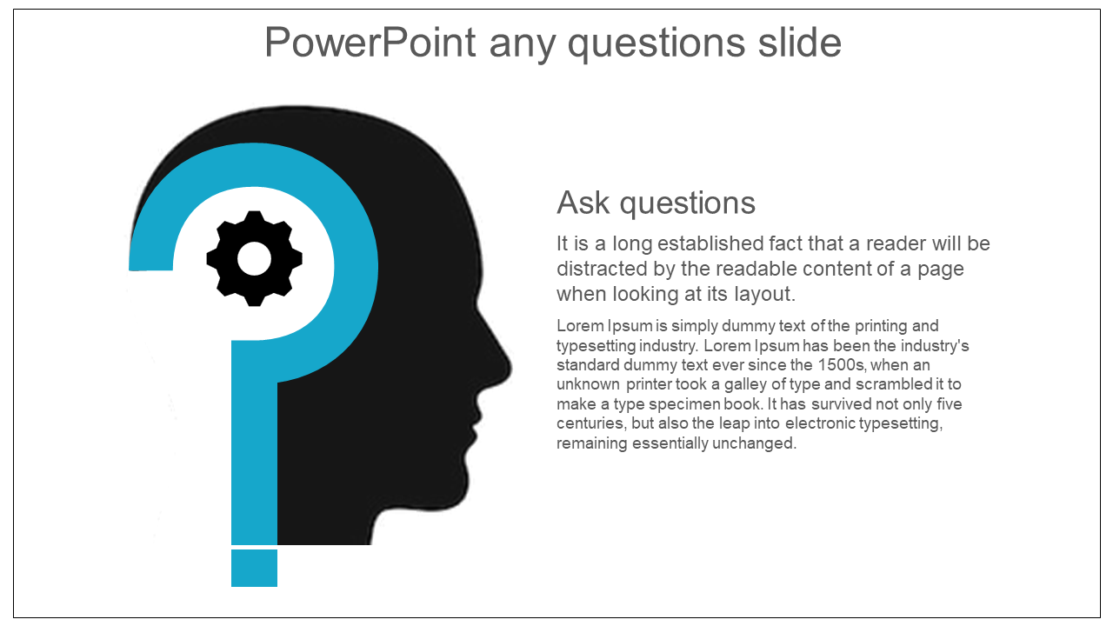


Slide 33

THANK YOU

